Slide 1
Personas
Sogeti Smart Workspace

Slide 2
Personas
An overview in Sogeti Smart Workspace
v1.1

Slide 3
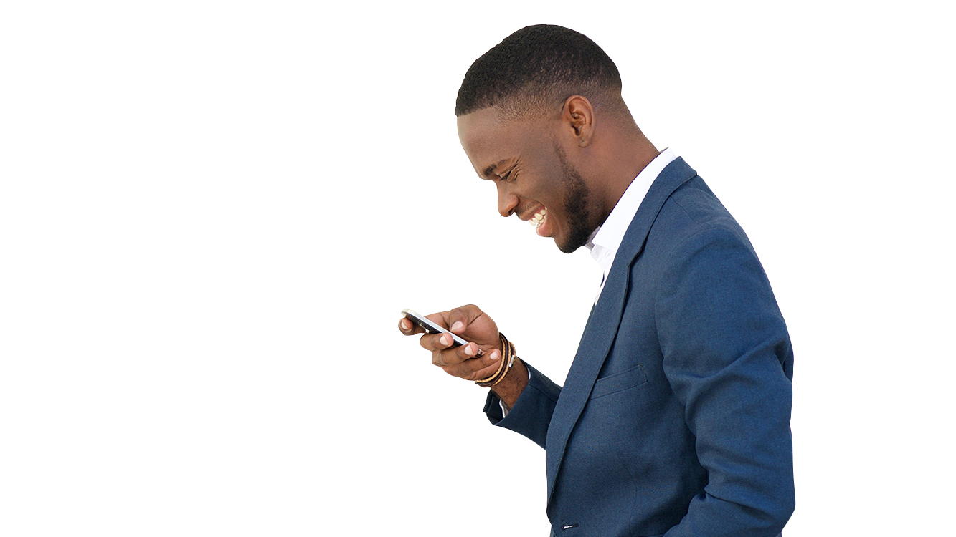
Definitions

Slide 4
Building blocks in Smart Workspace
From a user's perspective, the workspace is built from the following components:
The user, who in the workspace appears as the identity: the account that is used to login to the workspace. Access to resources in the workspace is assigned to this identity.
The device with which the user works in the workspace. Typical devices are laptops, desktops, smartphones and tablets. Both can be corporate (managed) and personal (unmanaged).
The applications available for the user in the workspace. Applications appear in different types: locally installed, web based/SaaS or on a remote workspace.
The data – information that is processed in the workspace and is stored in different locations (OneDrive, Teams/SharePoint, fileservers, etc.)

Slide 5
The user
The starting point is equal for all corporate users, providing each user with:
A personal account in (Azure) Active Directory, to login to the Smart Workspace and obtain access to services offered within the Smart Workspace environment.
A Microsoft 365 subscription* in the Azure tenant. This subscription provides a productivity hub, including a personal mailbox and personal storage location, and a collaboration platform, with Teams and SharePoint.
An EM+S subscription*, optionally included in the M365 subscription, to safely grant and control access to corporate resources in the workspace.
*Different subscriptions are possible, such as E1, E3 or E5 and F3. The subscription determines the capabilities for the user.

Slide 6
Devices
Accessing the Smart Workspace and its building blocks (Application Portal, Office 365, Remote workspace, etc.) can be achieved using different device types:
Laptop
Desktop
Tablet
Smartphone
Other
The form factor and Operating System on the device (capabilities), combined with the level of trust (managed / unmanaged and health state) determine the level of access to services and resources in the workspace.
The user’s primary device in Smart Workspace is a Windows 10 laptop or desktop. Most users have a company owned or personally owned smartphone or tablet as their secondary device. By default, these devices are MAM managed, where only ownership differs. Optionally, company owned devices can be MDM managed.

Slide 7
Applications
The following application types are used within the workspace:
Locally installed applications, for example Office 365 apps
Web-based applications, including SaaS, reached over the internet
Web-based applications, hosted in the local datacenter
Datacenter executed front-end applications, offered through a remote workspace solution like Azure Virtual Desktop or Citrix Workspace
Users launch applications from the application portal, which is a single pane of glass to access all applications users are entitled for, regardless their execution (local, web or remote). Standard users have a base set of local applications pre-installed and can request and install additional applications from the application portal.

Slide 8
Data
Within the workspace, we distinguish the following data sources:
Personal data, stored on the user’s OneDrive
Shared data, used for collaboration, stored in SharePoint Online and/or Teams
Application Data, stored in databases or storage on file servers in the datacenter
Depending on the device used (level of trust), application and connection (inside or outside of the Office, optionally with or without VPN connection) data may or may not be accessible.

Slide 9
Context
The characteristics and context determine how users will or can use the workspace and its content. The possible contexts determines the requirements that should be fulfilled in the Smart Workspace, in order to support the users in their day-to-day operations.
Examples of contexts are:
Location
Working from an Office location
Working from home
Working while travelling
Autonomy, the options for users to change the workspace to specific needs. An example is having administrator (-like) permissions
<continued on next page>

Slide 10
Context
Device
Laptop, desktop, smartphone or tablet
Shared use or personal use
Operating System (Windows, macOS, Android, iOS)
Ownership (company owned or personal owned - BYOD)
Role, the user's role or function in the organization
Manager
Developer
Production employee
Applications used, for example only web or also datacenter executed apps

Slide 11
Personas

Slide 12
Persona overview
Based on the previous definitions, we distinguish the following personas:
Task worker
Knowledge worker
Tech worker
Web worker

Slide 13
Task worker
The Task worker primarily works from a single office location, using business applications that support the company’s primary process. Preferably, these applications are web based or SaaS. Since this is not a reality in most organizations today, some business applications are datacenter executed and accessed through a remote workspace solution. Secondary, Task workers use the applications that are part of Office 365, for productivity use and collaboration and generic applications, such as applications for time management, facilities and the IT support application (ITSM) .
The Task workers’ primary device is a corporate owned, fully managed, shared desktop with ‘standard user’ permissions. Using this device enables the Task worker to utilize all required features within the workspace. Because of the shared usage of the device, some features are not available for Task workers. For example, this concerns features like OneDrive synchronization and (optionally) the use of locally installed Office apps for users with an Office 365 F3 subscription.
Task worker users can use their personal owned device but, within corporate security boundaries, this may involve limited functionality and/or access to company resources.

Slide 14
Knowledge worker
The Knowledge worker is a mobile user, working from different offices and from home. Primary applications used by this persona are based on collaboration within one or more teams, using the capabilities in Office 365. Personal and shared information is stored within Office 365.
Secondary use are (generic) applications, such as (web based) applications for time management, facilities and the IT support application (ITSM).
The Knowledge workers’ primary device is a corporate owned, fully managed, personal laptop with ‘standard user’ permissions. Using this device enables the knowledge user to fully utilize all features within the workspace.
Knowledge Worker users can use their personal owned device but, within corporate security boundaries, this may involve limited functionality and/or access to company resources.

Slide 15
Tech worker
The Tech worker looks like the Knowledge Worker in the sense of mobility and collaboration. The main difference is, these users need the ability on their device to apply configuration changes and install specific applications for their tasks (autonomy). Example Tech workers are IT Admins and Developers.
The Tech workers’ primary device is a corporate owned, fully managed, personal laptop with ‘local administrator’ (-like*) permissions. Using this device enables the tech user to fully utilize all features within the workspace and to configure the device to their specific needs.
Tech workers can use their personal owned device but, within corporate security boundaries, this may involve limited functionality and/or access to company resources.
*As a best practice, an additional Endpoint Privilege Access Management solution should be used to manage privileged access.

Slide 16
Web worker
Web Workers need access to web applications only, including SaaS, using the corporate browser. Typically, these are users that incidentally require access to (web based) applications or a single web application. For example, users in reception or production process.
The Web workers’ primary device is a corporate owned, fully managed, shared desktop configured in Single Kiosk mode. Users can only use applications from the web browser and cannot store data locally on the device or launch locally installed applications.
By default, Web workers login with their corporate account to the desktop. As an alternative, anonymous login can be configured enabling access for guest users (visitors).
Web workers (excluding guests) can use their personal owned device but, within corporate security boundaries, this may involve limited functionality and/or access to company resources.

Slide 17
Summary

Slide 18
Summary
 | Task Worker | Knowledge Worker | Tech Worker | Web Worker
Primary Location | Office (fixed) | Office (differs) | Office (differs) | Office (fixed)
Work from home | Occasionally | Frequent | Frequent | n.a.
Primary device (company owned) | Shared Desktop | Personal Laptop | Personal Laptop | Kiosk Desktop
Secondary device | Personally owned | Company or personally owned | Company or personally owned | Personally owned
Local and generic Apps | Secondary | Primary | Primary | n.a.
Business Apps | Primary | Optional | Optional | Web only
Autonomy (privileged device access) | n.a. | n.a. | Yes | n.a.

